Slide 1
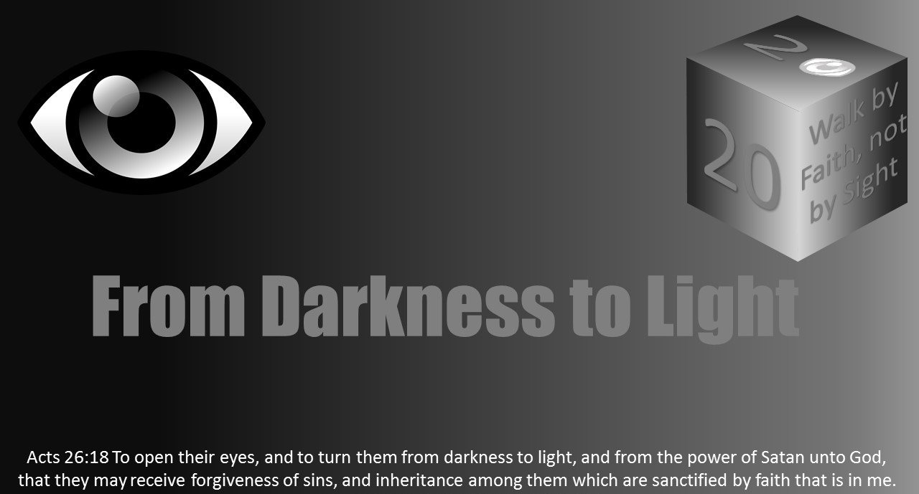



Slide 2

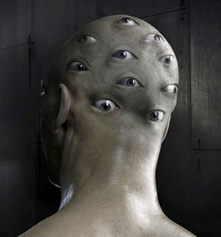
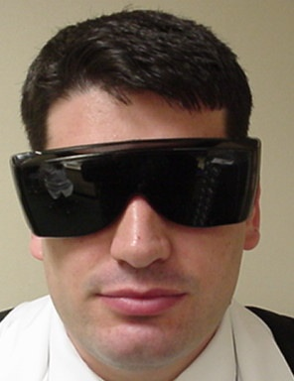
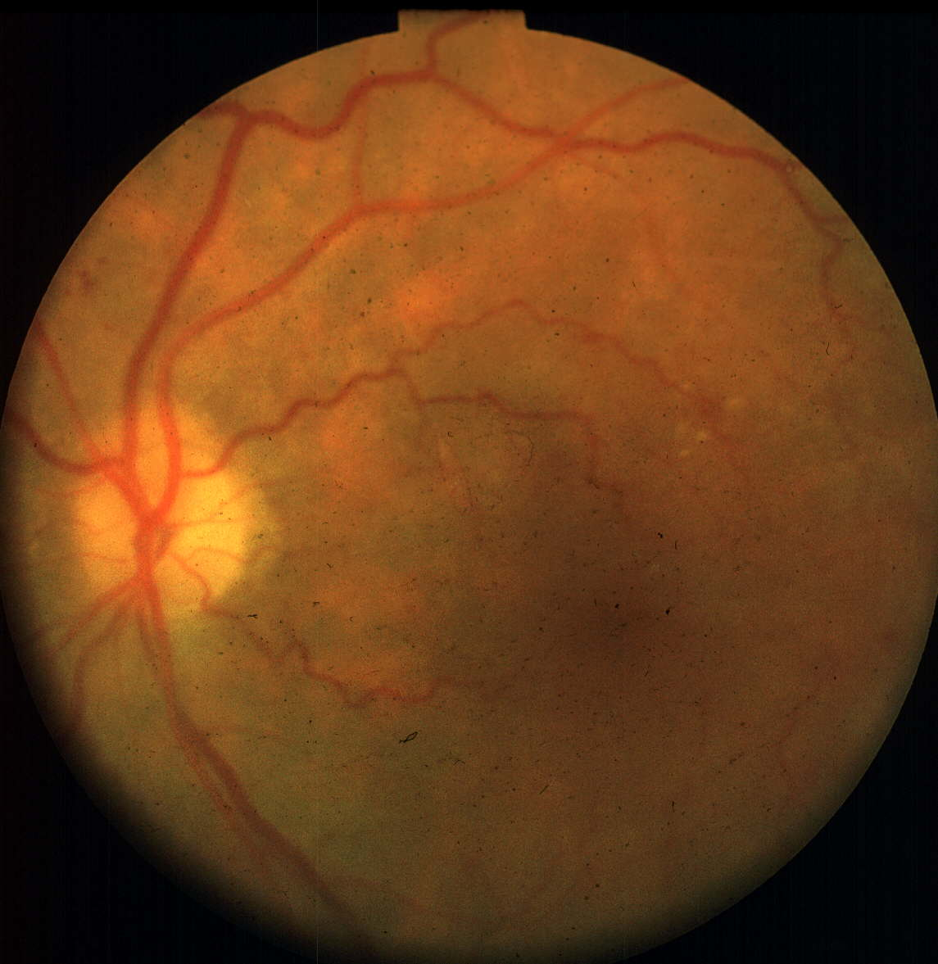
Lesson 3: Combating Spiritual Blindness
John 8:12: “I am the light of the world: he that followeth me shall not walk in darkness, but shall have the light of life.”
Notes:
Optometrists spend their professional careers thinking about how to combat vision problems and blindness. Often glasses or a contact lens prescription addresses the concern. Other times, a medication to combat a disease like glaucoma is required. In the previous lesson, a myriad of causes of spiritual blindness has been discussed. Some examples included the pride of life, the lust of the flesh, the lust of the eyes. Character traits such as self-righteousness, alcohol/drug abuse, disobedience/rebellion, greed/mammon, hypocrisy, and prejudice can lead to spiritual blindness. And finally, certain actions like a failure to recognize God, seeking men’s approval, and a failure to know God’s word can be a contributor.
When suffering from spiritual blindness, can one combat it to help improve one’s vision? The Christian must use their eternal prism or lens of faith to look not at the temporal, but at the eternal. So, how do Christians combat spiritual blindness?

Slide 3
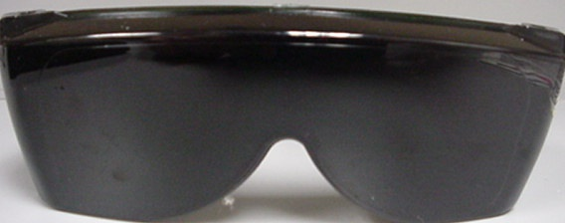
Some Causes of Spiritual Blindness
Pride
Self-righteousness
Lust
Alcohol/Drugs
Disobedience/Rebellion
Failure to recognize God
Unjust gain/greed
Pride of Life: Men’s approval/hypocrisy/ uncommitted Heart
Prejudice
Failure to know God’s word
Notes:
There are many causes of spiritual blindness.
Some include: pride, lust of the flesh, the lust of the eyes, self-righteousness, alcohol and drugs, disobedience/rebellion, a failure to recognize God, greed and mammon, hypocrisy, seeking men’s approval (pride of life items), prejudice, and a failure to know God’s word.
It is easy to delude ourselves into just being a hearer and not a doer of the word leading to a state of spiritual blindness.

Slide 4
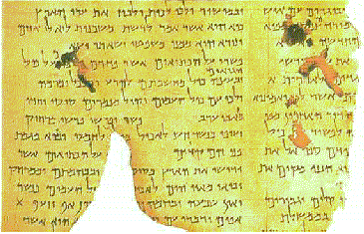
How do Christians combat spiritual blindness?
Open their eyes to the Law
Psalms 119:18 ¹⁸Open thou mine eyes, that I may behold wondrous things out of thy law.
Use The Light
Notes:
Use the Light
The Christian must be careful not to think of themselves more highly than they ought.
To combat spiritual blindness, the Christian must open their eyes to God’s instruction.
Psalms 119:18 encourages, “Open thou mine eyes, that I may behold wondrous things out of thy law.”

Slide 5

How do Christians combat spiritual blindness?
Shine forth as light to those in darkness
Mt 5:15-16 Neither do men light a candle, and put it under a bushel, but on a candlestick; and it giveth light unto all that are in the house. ¹⁶Let your light so shine before men, that they may see your good works, and glorify your Father which is in heaven.
Use The Light
Notes:
It is the Christian who must shine forth as a light to those in darkness and spiritual blindness.
Matthew 15:15-16 reads, “Neither do men light a candle, and put it under a bushel, but on a candlestick; and it giveth light unto all that are in the house. Let your light so shine before men, that they may see your good works, and glorify your Father which is in heaven.”
The smallest of lights are incredibly bright and powerful when surrounded in darkness.

Slide 6
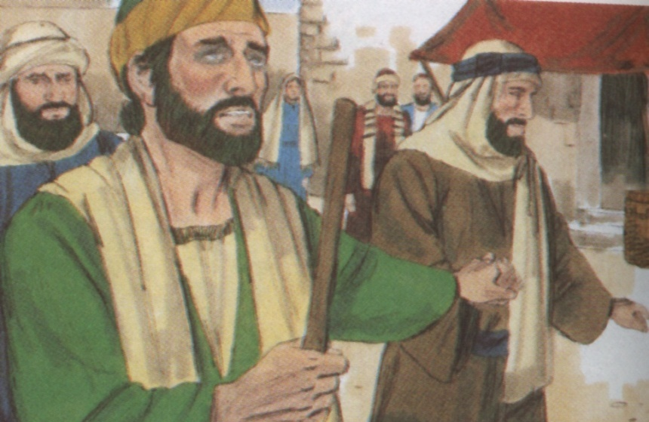
How do Christians combat spiritual blindness?
Paul is an example to us
Struck blind on the road to Damscus
Acts 9:8-9 And Saul arose from the earth; and when his eyes were opened, he saw no man: but they led him by the hand, and brought him into Damascus. ⁹And he was three days without sight, and neither did eat nor drink.
Acts 9:18 ¹⁸And immediately there fell from his eyes as it had been scales: and he received sight forthwith, and arose, and was baptized.
Paul’s Example
Notes:
Paul's Example
Paul is an example to Christians in combating spiritual blindness.
He was struck physically blind on the road to Damascus.
Acts 9:8-9 reads, “And Saul arose from the earth; and when his eyes were opened, he saw no man: but they led him by the hand, and brought him into Damascus. And he was three days without sight, and neither did eat nor drink.” Of course, Paul did as instructed and waited.
Once he was told what to do, Paul responded as one reads in Acts 9:18, “And immediately there fell from his eyes as it had been scales: and he received sight forthwith, and arose, and was baptized.”
Not only had Paul been physically blind, but while persecuting the church, he was not seeing what God wanted him to do spiritually. Paul acted upon understanding what he was supposed to do. He waited three days without sight or eating or drinking. Paul obviously prepared himself in that time to do whatever he needed to do. God returned his sight physically and repurposed Paul spiritually

Slide 7
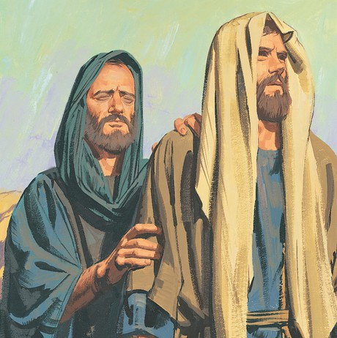
How do Christians combat spiritual blindness?
Paul carried light to the Gentiles
Acts 26:17-18 ⁷Delivering thee from the people, and from the Gentiles, unto whom now I send thee, ¹⁸To open their eyes, and to turn them from darkness to light, and from the power of Satan unto God, that they may receive forgiveness of sins, and inheritance among them which are sanctified by faith that is in me.
Paul’s Example
Notes:
Paul would go on to carry the gospel light to the Gentiles.
Acts 26:17-18 reads “Delivering thee from the people, and from the Gentiles, unto whom now I send thee, To open their eyes, and to turn them from darkness to light, and from the power of Satan unto God, that they may receive forgiveness of sins, and inheritance among them which are sanctified by faith that is in me."
Paul gives the Christian an example of obedience from when he was spiritually blinded.

Slide 8
How do Christians combat spiritual blindness?
Jews were veiled or blinded to truth
2 Cor 3:14-15 But their minds were blinded: for until this day remaineth the same vail untaken away in the reading of the old testament; which vail is done away in Christ. ¹⁵But even unto this day, when Moses is read, the vail is upon their heart.
Jew’s Example
Notes:
The Jews were also veiled or blinded to truth.
Paul wrote how their spiritual blindness had existed since Moses.
2 Cor 3:14-15 reads, “But their minds were blinded: for until this day remaineth the same veil untaken away in the reading of the old testament; which veil is done away in Christ. But even unto this day, when Moses is read, the veil is upon their heart.”

Slide 9
How do Christians combat spiritual blindness?
Christians must carry the gospel light to others -- they are blind in darkness. Are we?
2 Cor 4:3-6 ³But if our gospel be hid, it is hid to them that are lost: ⁴In whom the god of this world hath blinded the minds of them which believe not, lest the light of the glorious gospel of Christ, who is the image of God, should shine unto them. ⁵For we preach not ourselves, but Christ Jesus the Lord; and ourselves your servants for Jesus’ sake. ⁶For God, who commanded the light to shine out of darkness, hath shined in our hearts, to give the light of the knowledge of the glory of God in the face of Jesus
Jew’s Example
Notes:
Now, Christians must carry the gospel light to others that are blind in darkness.
The question is: Are Christians seeking the lost with the light of the Gospel?
2 Corinthians 4:3-6 warns, “But if our gospel be hid, it is hid to them that are lost: In whom the god of this world hath blinded the minds of them which believe not, lest the light of the glorious gospel of Christ, who is the image of God, should shine unto them. For we preach not ourselves, but Christ Jesus the Lord; and ourselves your servants for Jesus’ sake. For God, who commanded the light to shine out of darkness, hath shined in our hearts, to give the light of the knowledge of the glory of God in the face of Jesus.”

Slide 10
How do Christians combat spiritual blindness?
Christians are carrying the light of the kingdom into the darkness of the world
1 Thes 5:4-8 But ye, brethren, are not in darkness, that that day should overtake you as a thief. ⁵Ye are all the children of light, and the children of the day: we are not of the night, nor of darkness. ⁶Therefore let us not sleep, as do others; but let us watch and be sober. ⁷For they that sleep sleep in the night; and they that be drunken are drunken in the night. ⁸But let us, who are of the day, be sober, putting on the breastplate of faith and love; and for an helmet, the hope of salvation.
Jew’s Example
Notes:
Christians have the work of carrying the light of the kingdom of God into the darkness of the world!
1 Thes 5:4-8 reads, “But ye, brethren, are not in darkness, that that day should overtake you as a thief. Ye are all the children of light, and the children of the day: we are not of the night, nor of darkness. Therefore let us not sleep, as do others; but let us watch and be sober. For they that sleep sleep in the night; and they that be drunken are drunken in the night. But let us, who are of the day, be sober, putting on the breastplate of faith and love; and for an helmet, the hope of salvation.”
The Christian must make sure they are not blinded to the truth or veiled in their sight of the mission God has given them to bring others to His grace and righteousness.

Slide 11
How do Christians combat spiritual blindness?
Christians abstain from lusts, pride, sin, hypocrisy
1 Peter 2:9-10 But ye are a chosen generation, a royal priesthood, an holy nation, a peculiar people; that ye should shew forth the praises of him who hath called you out of darkness into his marvellous light: ¹⁰Which in time past were not a people, but are now the people of God: which had not obtained mercy, but now have obtained mercy. ¹¹Dearly beloved, I beseech you as strangers and pilgrims, abstain from fleshly lusts, which war against the soul;
Walk As Children of Light
Notes:
Walk As Children of Light
Christians build their lives on the promises of God. Those promises allow Christians to cleanse themselves from the corruption of the world and abstain from lust, pride, sin, and hypocrisy. This allows the Christian to become partakers of the divine nature or God’s holiness through Christ.
1 Peter 2:9-11 teaches, “But ye are a chosen generation, a royal priesthood, an holy nation, a peculiar people; that ye should shew forth the praises of him who hath called you out of darkness into his marvellous light: Which in time past were not a people, but are now the people of God: which had not obtained mercy, but now have obtained mercy. Dearly beloved, I beseech you as strangers and pilgrims, abstain from fleshly lusts, which war against the soul.”

Slide 12
How do Christians combat spiritual blindness?
Christians are to not sin, but walk as children of light
Eph 4:17-18 This I say therefore, and testify in the Lord, that ye henceforth walk not as other Gentiles walk, in the vanity of their mind, ¹⁸Having the understanding darkened, being alienated from the life of God through the ignorance that is in them, because of the blindness of their heart:
Walk As Children of Light
Notes:
Christians are to put away sin and walk as children of light.
Ephesians 4:17-18 explains, “This I say therefore, and testify in the Lord, that ye henceforth walk not as other Gentiles walk, in the vanity of their mind, Having the understanding darkened, being alienated from the life of God through the ignorance that is in them, because of the blindness of their heart.”

Slide 13
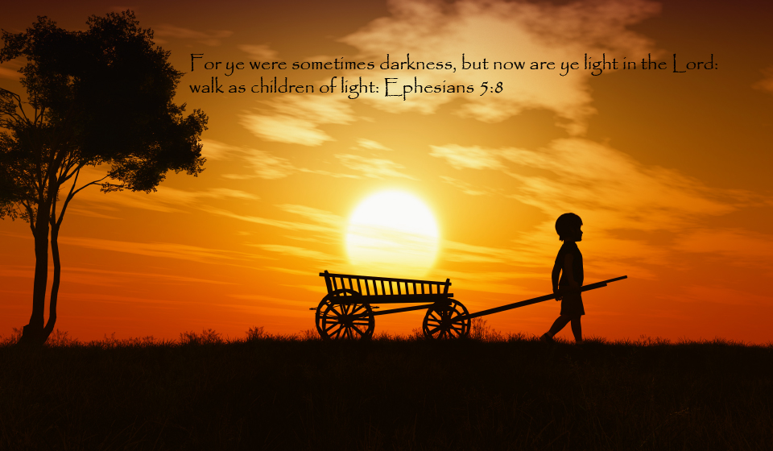
How do Christians combat spiritual blindness?
Eph 5:7-8 ⁷Be not ye therefore partakers with them. ⁸For ye were sometimes darkness, but now are ye light in the Lord: walk as children of light:
Are we endeavoring to avoid sin as we should or do we see how close we can get?
Walk As Children of Light
Notes:
Similarly, Ephesians 5:7-8 instructs, “Be not ye therefore partakers with them. For ye were sometimes darkness, but now are ye light in the Lord: walk as children of light.”
Are Christians endeavoring to avoid sin as they should or do they see how close they can be like the world?

Slide 14
How do christians combat spiritual blindness?
Love one another
1 John 2:9-11 ⁹He that saith he is in the light, and hateth his brother, is in darkness even until now. ¹⁰He that loveth his brother abideth in the light, and there is none occasion of stumbling in him. ¹¹But he that hateth his brother is in darkness, and walketh in darkness, and knoweth not whither he goeth, because that darkness hath blinded his eyes.
Walk As Children of Light
Notes:
Christians must also love one another to walk in the light.
1 John 2:9-11 teaches, “He that saith he is in the light, and hateth his brother, is in darkness even until now. He that loveth his brother abideth in the light, and there is none occasion of stumbling in him. But he that hateth his brother is in darkness, and walketh in darkness, and knoweth not whither he goeth, because that darkness hath blinded his eyes.”
Too often, people are blinded by hate toward others, failing to remember the other person was created in the image of God and failing to act in love (Genesis 1:27 and Matthew 5:38-48).

Slide 15
How do Christians combat spiritual blindness?
Good works - Shine forth
Remember the Laeodecians
Are we lukewarm?
Do we show our faith by our works?
Walk As Children of Light
Notes:
Christians should understand their worship and service may help and even entertain them, but worship is about God and His glory.
Worship is not about what the worshipper gets, but is about serving a Holy, Holy, Holy God.
The scriptures teach that the Christian’s good works should shine forth.
In Revelation 3, one can consider the lukewarm Laeodecians.
Why are folks lukewarm today? How do Christians show their faith by their works?
Love and the resulting works in the name of Christ done in faith allows all to see.
Good works are understood without translation of language and are seen by the blind.

Slide 16
How do Christians combat spiritual blindness?
Christians must grow or become blind
Amblyopia (lazy eye)
2 Pet 1:3-9 ³According as his divine power hath given unto us all things that pertain unto life and godliness, through the knowledge of him that hath called us to glory and virtue: ⁴Whereby are given unto us exceeding great and precious promises: that by these ye might be partakers of the divine nature, having escaped the corruption
Walk As Children of Light
Notes:
Christians must grow or become blind.
In the human visual system, amblyopia is a lazy eye, either because the eye turns (strabismus) or has a large refractive error.
Refraction measures the power needed in glasses to let an eye see well.
Sometimes, an eye fails to develop properly when it is significantly underutilized compared to its fellow eyes because of the difference from its fellow eye, such that no matter what power is placed in the glasses, the eye will not see well.
It is no longer neurologically “wired” to see normally.
This is amblyopia.
In comparison, one might imagine how this might work with another body part.
For example, if one's right arm was tied behind their back such that only the left arm was used for an entire year, the left arm would gain in strength while the right would wane in strength.
Growth and use is important in combating spiritual blindness.
Christians must exercise God’s promises to escape lust and become partakers of God’s holiness.

Slide 17
How do Christians combat spiritual blindness?
(2 Peter 1 cont’d) that is in the world through lust. ⁵And beside this, giving all diligence, add to your faith virtue; and to virtue knowledge; ⁶And to knowledge temperance; and to temperance patience; and to patience godliness; ⁷And to godliness brotherly kindness; and to brotherly kindness charity. ⁸For if these things be in you, and abound, they make you that ye shall neither be barren nor unfruitful in the knowledge of our Lord Jesus Christ. ⁹But he that lacketh these things is blind, and cannot see afar off, and hath forgotten that he was purged from his old sins.
Walk As Children of Light
Notes:
2 Peter 1:3-9 instructs, “According as his divine power hath given unto us all things that pertain unto life and godliness, through the knowledge of him that hath called us to glory and virtue: Whereby are given unto us exceeding great and precious promises: that by these ye might be partakers of the divine nature, having escaped the corruption that is in the world through lust. And beside this, giving all diligence, add to your faith virtue; and to virtue knowledge; And to knowledge temperance; and to temperance patience; and to patience godliness; And to godliness brotherly kindness; and to brotherly kindness charity. For if these things be in you, and abound, they make you that ye shall neither be barren nor unfruitful in the knowledge of our Lord Jesus Christ. But he that lacketh these things is blind, and cannot see afar off, and hath forgotten that he was purged from his old sins.”
If Christians fail to exercise God’s promises in their life, then they have a form of spiritual amblyopia. Then, a person is vulnerable to the corruption that is in the world through lust. If they do not escape it, it will take control of their life.
Christians instead must seek to grow in God’s promises so they can become partakers of God’s divine nature and holiness.
Christians need to exercise their faith recognizing their dependence on God. This cancels pride.
Failure to grow or use what God has given can result in a form of spiritual amblyopia or spiritual blindness.

Slide 18
How do Christians combat spiritual blindness?
Need to exercise our faith, recognizing our dependence on God. Cancels pride.
Grow in God’s promises to become partaker’s of the divine nature and holiness.
Blind were healed by Jesus by their faith in Mk 10:46-52
Walk As Children of Light

Slide 19

How do Christians combat spiritual blindness?
Don’t be snared by materialism and greed; Seek to help others in need
Prov 23:4-5 Labour not to be rich: cease from thine own wisdom. ⁵Wilt thou set thine eyes upon that which is not? for riches certainly make themselves wings; they fly away as an eagle toward heaven.
Parable of sower and soils: Riches often act as thistles to choke us with cares of the world
Prov 28:27 He that giveth unto the poor shall not lack: but he that hideth his eyes shall have many a curse.
Walk As Children of Light
Notes:
Another corruption that is in the world through lust is materialism and greed.
While avoiding the snare of greed, Christians need to be seeking to help others in need.
Proverbs 23:4-5 teaches, "Labour not to be rich: cease from thine own wisdom. Wilt thou set thine eyes upon that which is not? for riches certainly make themselves wings; they fly away as an eagle toward heaven.”
In the same fashion, the parable of the sower and soils in Matthew 13:22 warns that riches often act as thistles to choke Christians with the care of the world. (See also Heb 6:8).
Proverbs 28:27 encourages, “He that giveth unto the poor shall not lack: but he that hideth his eyes shall have many a curse.” Do I hide my eyes? Are my eyes generous?

Slide 20
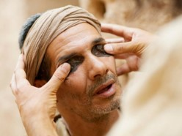
How do christians combat spiritual blindness?
Use the Light: Seek the Law/God’s Word
Be the Light: Shine as light to the world
Shine gospel light to the world
Walk as children of Light:
Abstain from lust, pride, sin, hypocrisy
Love one another
Grow as a Christian
Demonstrate love
Avoid greed and materialism
Notes:
Christ Cures Blindness
In John 8:12, Jesus encourages His followers, "I am the light of the world: he that followeth me shall not walk in darkness, but shall have the light of life.”
Combating spiritual blindness involves many things.
Some things the Christian can do include:
seeking God’s instruction;
shining as light to the world while reflecting God’s light and love;
walking as children of light;
and abstaining from lust, pride, prejudice, sin, and hypocrisy;
and demonstrating love to one another.
The smallest light of love in the darkness of this world shines as a beacon to those who do not have that light.
The process of growing in the promises of God allow the Christian to be fruitful in His kingdom.
Lastly, Christians seek to escape the corruption in the world through lust including putting away materialism and greed.

Slide 21
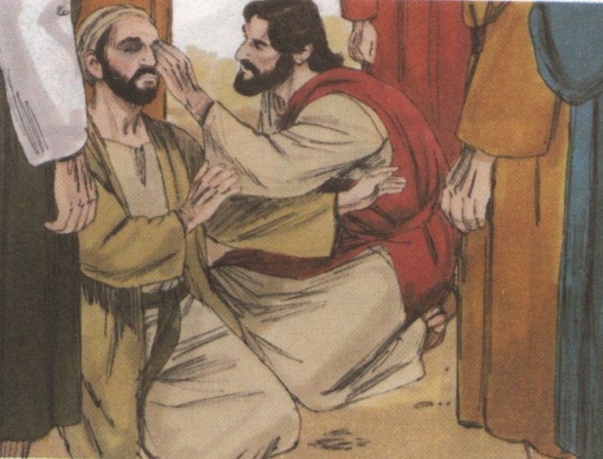
Christ Cures Blindness
Many wanted to see Jesus, and we can recognize him from the history recorded for us
Mt 13:14-19 ¹⁴And in them is fulfilled the prophecy of Esaias, which saith, By hearing ye shall hear, and shall not understand; and seeing ye shall see, and shall not perceive: ¹⁵For this people’s heart is waxed gross, and their ears are dull of hearing, and their eyes they have closed; lest at any time they should see with their eyes, and hear with their ears, and should understand
Notes:
Christ cured blindness physically during his ministry, but now He cures spiritual blindness.
Many wanted to see Jesus in His time on earth as His fame for curing blindness (and disease) had spread.
Mark 8:22-25 records such an event on the blind man of Bethsaida. These miracles allow one to recognize Jesus as the Christ. Jesus draws a parallel to those who could not see spiritually.
Matthew 13:14-19 records, “And in them is fulfilled the prophecy of Esaias, which saith, By hearing ye shall hear, and shall not understand; and seeing ye shall see, and shall not perceive: For this people’s heart is waxed gross, and their ears are dull of hearing, and their eyes they have closed; lest at any time they should see with their eyes, and hear with their ears, and should understand with their heart, and should be converted, and I should heal them. But blessed are your eyes, for they see: and your ears, for they hear. For verily I say unto you, That many prophets and righteous men have desired to see those things which ye see, and have not seen them; and to hear those things which ye hear, and have not heard them.”

Slide 22
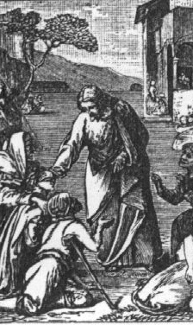
Christ Cures Blindness
(Matt 13 cont’d) with their heart, and should be converted, and I should heal them. ¹⁶But blessed are your eyes, for they see: and your ears, for they hear. ¹⁷For verily I say unto you, That many prophets and righteous men have desired to see those things which ye see, and have not seen them; and to hear those things which ye hear, and have not heard them.
Lk 4:18 Jesus came to give sight to the blind
Mk 8:22-25 Jesus cured blind man of Bethsaida
Notes:
Christians must be certain their eyes are not closed and their heart waxed gross by the carnal, but instead are focused on Christ and the eternal.
Luke 14:18 tells that Jesus came to give sight to the blind.
Jesus cures spiritual blindness today.

Slide 23
Christ Cures Blindness
Jesus is the light unto the world
Jn 1:5-10 And the light shineth in darkness; and the darkness comprehended it not. ⁶There was a man sent from God, whose name was John. ⁷The same came for a witness, to bear witness of the Light, that all men through him might believe. ⁸He was not that Light, but was sent to bear witness of that Light. ⁹That was the true Light, which lighteth every man that cometh into the world. ¹⁰He was in the world, and the world was made by him, and the world knew him not.
Notes:
Jesus is the light unto the world. He is the cure to darkness and spiritual blindness.
John 1:5-10 instructs, “And the light shineth in darkness; and the darkness comprehended it not. There was a man sent from God, whose name was John. The same came for a witness, to bear witness of the Light, that all men through him might believe. He was not that Light, but was sent to bear witness of that Light. That was the true Light, which lighteth every man that cometh into the world. He was in the world, and the world was made by him, and the world knew him not.”

Slide 24
Christ Cures Blindness
John 3:16-20 For God so loved the world, that he gave his only begotten Son, that whosoever believeth in him should not perish, but have everlasting life. ¹⁷For God sent not his Son into the world to condemn the world; but that the world through him might be saved. ¹⁸He that believeth on him is not condemned: but he that believeth not is condemned already, because he hath not believed in the name of the only begotten Son of God. ¹⁹And this is the condemnation, that light is come into the world, and men loved darkness rather than light, because their deeds were evil. ²⁰For every one that doeth evil hateth the light, neither cometh to the light, lest his deeds should be reproved. ²¹But he that doeth truth cometh to the light, that his deeds may be made manifest, that they are wrought in God.
Notes:
Similarly, John 3:16-21 reads, “For God so loved the world, that he gave his only begotten Son, that whosoever believeth in him should not perish, but have everlasting life. For God sent not his Son into the world to condemn the world; but that the world through him might be saved. He that believeth on him is not condemned: but he that believeth not is condemned already, because he hath not believed in the name of the only begotten Son of God. And this is the condemnation, that light is come into the world, and men loved darkness rather than light, because their deeds were evil. For everyone that doeth evil hateth the light, neither cometh to the light, lest his deeds should be reproved. But he that doeth truth cometh to the light, that his deeds may be made manifest, that they are wrought in God.”
Jesus is the Light that Christians must focus on as taught in Hebrews 12:2.
Jesus is the Light that Christians must reflect in their lives.
Jesus is the light that Christians must share to those who are suffering from spiritual blindness.

Slide 25
Christ Cures Blindness: The Blind Men of John 9
John 9
Man not blind because of his sin or parents’ sin
Blindness was for God’s purpose
“As long as I am in this world, I am the Light of the world.”
Pharisees failed to recognize Christ as Lord despite miracles
Notes:
The Blind MEN of John 9
In John 9, Jesus’ disciples asked Him if the blind man they passed had sinned or his parents because he was born blind.
Jesus responds that it was not this man that sinned or his parents, but that the works of God might be displayed in him.
Jesus goes on to say we must work when it is day and not night.
Jesus then says, “As long as I am in this world, I am the Light of the world.”
He then spits and made a mud to apply to the man’s eyes and told him to go wash in the pool of Siloam. He was cured of his blindness.
The man was called to appear before the Pharisees. The Pharisees did not marvel at the miracle, but instead said Jesus was not from God because He did not keep the Sabbath.
Others asked how can a man who is a sinner do such signs? The former blind man stated Jesus was a prophet. The Jews even disputed it was the blind man until they interrogated his parents. The former blind man’s parents even told the questioners their son could speak for himself because they feared the Jews.
The Jewish questioners told the man the answer they wanted: Jesus was a sinner. The former blind man’s response was, “Whether he is a sinner, I do not know. One thing I do know, that though I was blind, now I see.” They pressed the man further to deny Jesus.

Slide 26
Christ Cures Blindness: The Blind Men of John 9
John 9:35-41 reads, "Jesus heard that they had cast him out; and when he had found him, he said unto him, Dost thou believe on the Son of God? He answered and said, Who is he, Lord, that I might believe on him? And Jesus said unto him, Thou hast both seen him, and it is he that talketh with thee. And he said, Lord, I believe. And he worshipped him. And Jesus said, For judgment I am come into this world, that they which see not might see; and that they which see might be made blind. And some of the Pharisees which were with him heard these words, and said unto him, Are we blind also? Jesus said unto them, If ye were blind, ye should have no sin: but now ye say, We see; therefore your sin remaineth.”
Christians can share Jesus as a cure to spiritual blindness, but some do not want the Cure.
Will you continue in blindness?
Notes:
After being cast out, Jesus talks to the formerly blind man again.
John 9:35-41 reads, "Jesus heard that they had cast him out; and when he had found him, he said unto him, Dost thou believe on the Son of God? He answered and said, Who is he, Lord, that I might believe on him? And Jesus said unto him, Thou hast both seen him, and it is he that talketh with thee. And he said, Lord, I believe. And he worshipped him. And Jesus said, For judgment I am come into this world, that they which see not might see; and that they which see might be made blind. And some of the Pharisees which were with him heard these words, and said unto him, Are we blind also? Jesus said unto them, If ye were blind, ye should have no sin: but now ye say, We see; therefore your sin remaineth.”
One man was cured of physical blindness in John 9.
The spiritual blindness of the Jewish leaders remained.
Clearly, the man’s physical blindness was for God’s purpose, not his or his parent’s sin.
The events demonstrated Jesus was the Christ, the Son of God. The
Pharisees failed to recognize the Christ despite the miracle. Their own lust for power and pride caused them to continue in spiritual blindness.

Slide 27
Conclusion
Christians can share Jesus as a cure to spiritual blindness, but some do not want the Cure.
Some choose to remain blind, love darkness, condemned.
The Jews remained with a veil on their vision for a long time.
Children of the Light by contrast must put away sin and avoid spiritual blindness.
God's instruction can help His children grow rather than deteriorate into amblyopia and blindness. Christ will cure their blindness.
Notes:
Christians can share Jesus as a cure to spiritual blindness, but some do not want the Cure.
They remain in darkness and on track for eternal condemnation.
Some choose to remain blind.
Such folks love the darkness and the things of this world.
The Jews remained with a veil on their vision for a long time.
Children of the Light by contrast must put away sin and avoid spiritual blindness.
God's instruction can help His children grow rather than deteriorate into amblyopia and blindness. Christ will cure their blindness.

